Slide 1
Iot project presentation
Smart Home dashboard
Mihai Serban

Slide 2
Agenda
Project Overview
Dashboard
Project Wiring
Individual Roles and Tasks
Phases and their tasks
Challenges and Accomplishments

Slide 3
Project overview
The IoT project focused on making a smart home. We collected data from sensors, sent it to the Raspberry Pi (Rpi), made decisions based on that data, and showed the results on the dashboard. The aim was to demonstrate how various parts of a smart home can work well together.

Slide 4
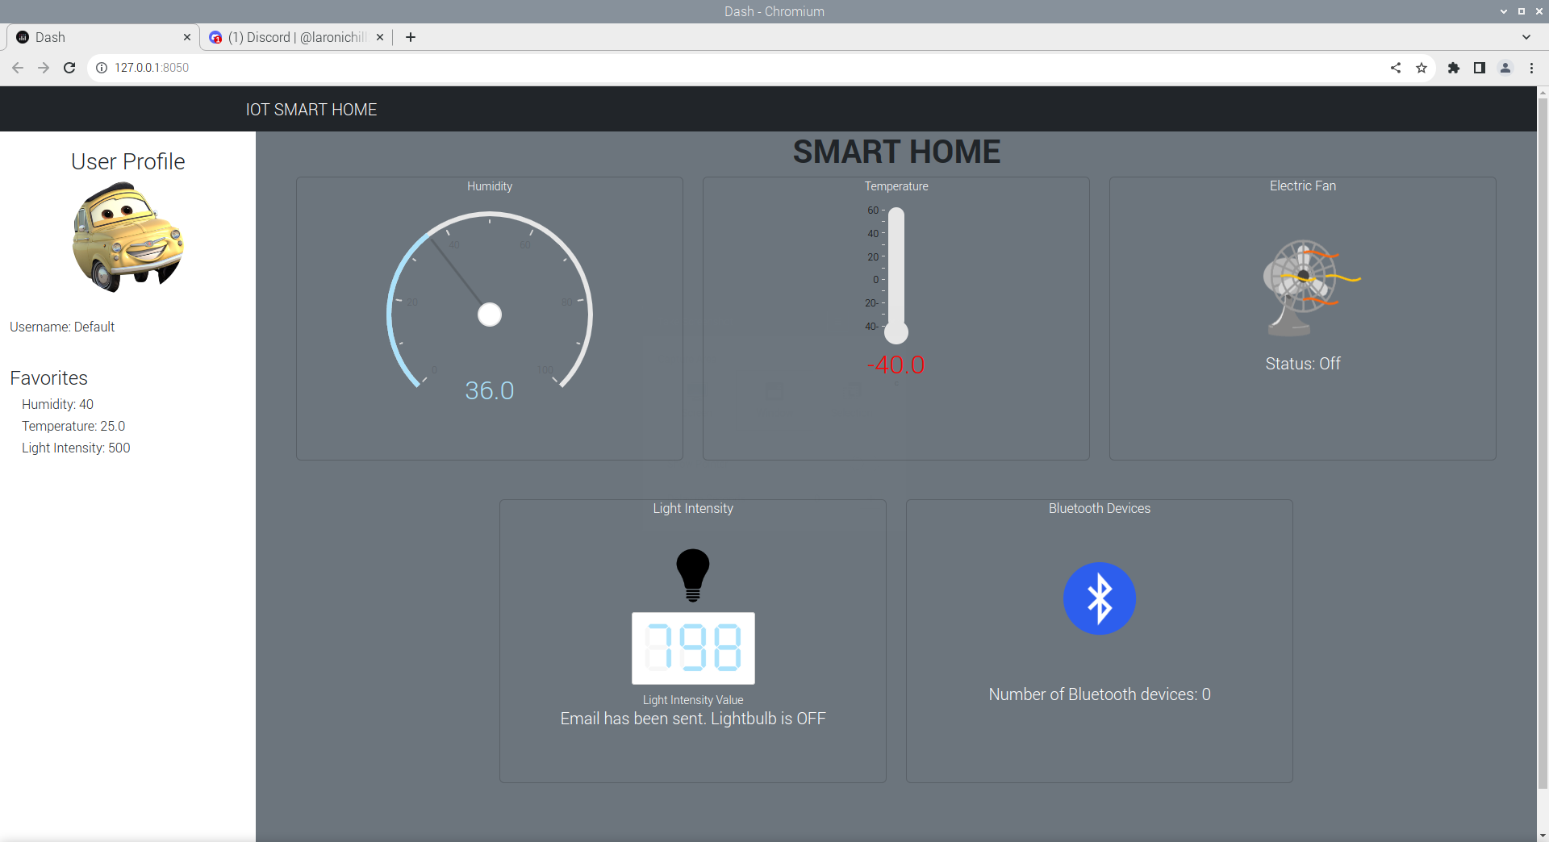
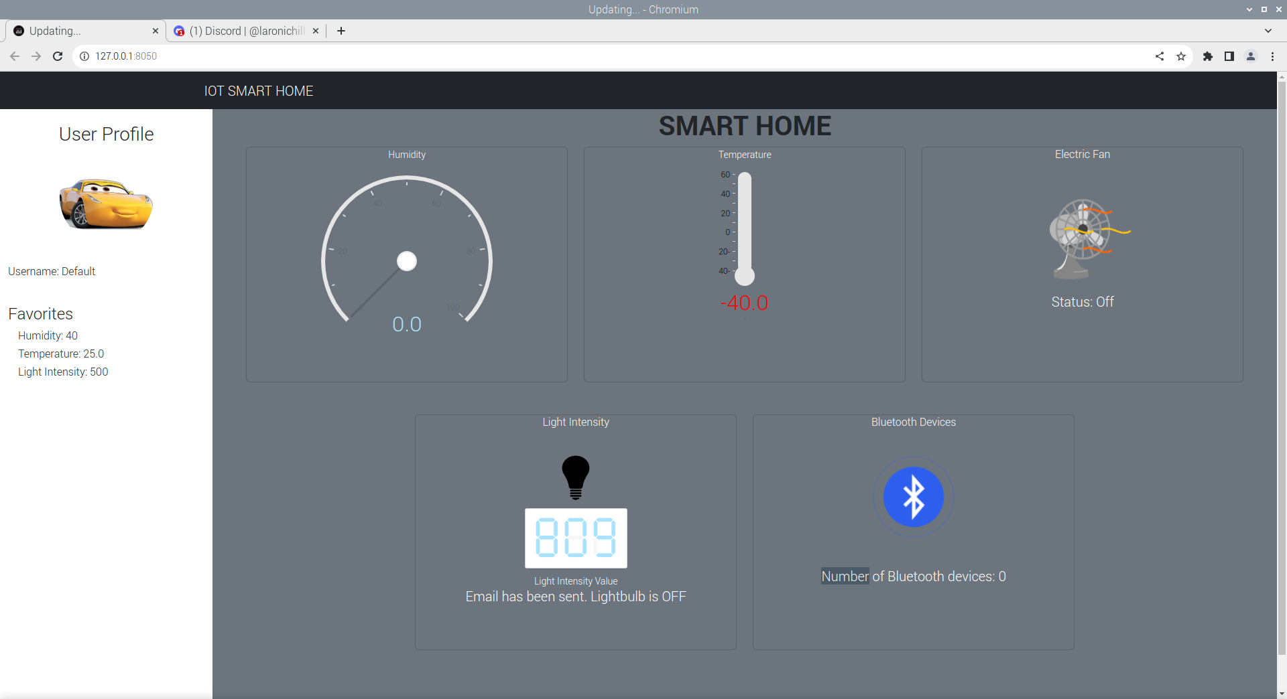
Dashboard
Default
RFID card tapped => User1

Slide 5
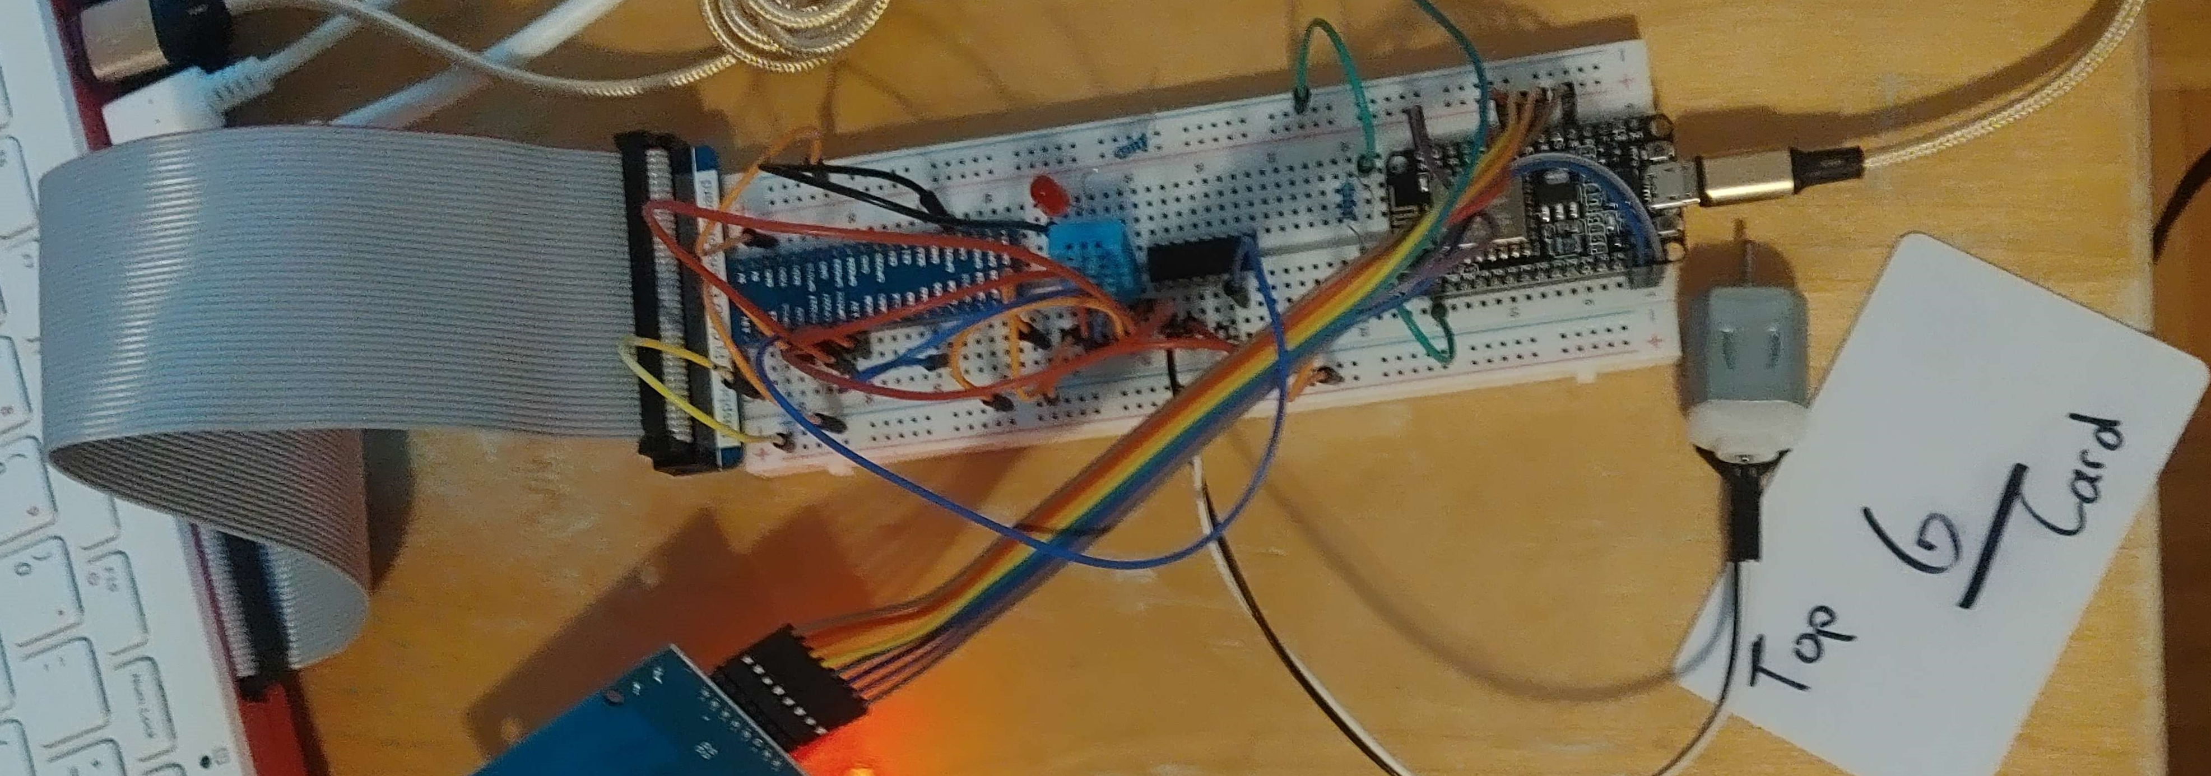
The project wiring

Slide 6
Individual Roles and Tasks
Phase 1
Jericho:
Wiring the breadboard
Sayem:
Creating the dashboard and styling
Change the image status of LED
Mihai:
Python Code: Turning on and off the led

Slide 7
Individual Roles and Tasks
Phase 2
Jericho:
Dashboard: CSS and components (gauges, fan, etc).
Capture environmental data with DHT11.
Displayed data in temperature and humidity gauges.
Send an email if the temperature is above the specified threshold.
Update fan image/gif depending on the status.
Sayem:
Python Code: Read the received email and if replies with “Yes”, update the fan status to “ON”.
Python Code: Verify if the email contains the word “Yes”.
Mihai:
Python Code: Turn On the motor

Slide 8
Individual Roles and Tasks
Phase 3
Jericho:
CSS and components
Subscribed to the MQTT topic and received the light intensity data.
Display light intensity on dashboard.
Send the email if the light intensity is below the specified threshold.
Turned on LED and changed LED status on dashboard.
Created the database
Sayem:
Captured Light intensity
Started Pub light intensity data onto the MQTT topic
Mihai:
Established wifi connection
Established MQTT server connection
Finished pub light intensity data onto the MQTT
server.
Wired the Breadboard

Slide 9
Individual Roles and Tasks
Phase 4
Mihai
Filled the database
Captured the RFID data
Pub the RFID ID to the MQTT topic
Sub to the MQTT topic and receive RFID data
Fetch user with matching User ID from the database
Display the user’s information on the dashboard
Send email saying {user name} has entered at this time
Wired the breadboard
Final test of every phase

Slide 10
Phases and their tasks
Phase 1 - description
In this phase, we create an IoT dashboard that can turn on and off a led on the breadboard from a simple click.

Slide 11
Phases and their tasks
Phase 1 - UTILITIES
Components
Resistors
Wires
LED
Breadboard
Raspberry Pi
Libraries
Dash
dash_daq
time
RPi.GPIO

Slide 12
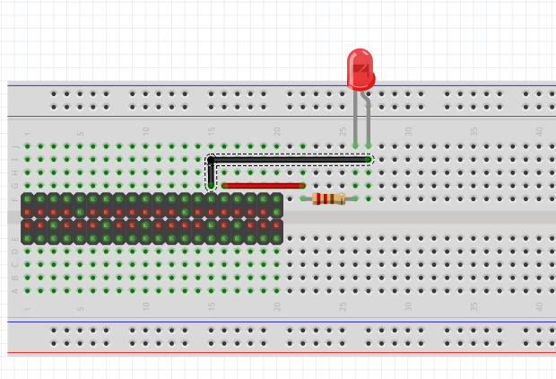
Phases and their tasks
Phase 1 - Wiring

Slide 13
Phases and their tasks
Phase 2 - description
In this phase, we create an IoT dashboard displaying temperature and humidity using gauges. When the temperature exceeds a certain threshold, an automatic email is sent to the user, asking if they want to start the fan. If the user agrees, the system activates the fan and updates its status on the dashboard. If not, no action is taken.

Slide 14
Phases and their tasks
Phase 2 - UTILITIES
Components
DHT11 Temperature and Humidity sensor
Resistors
Wires
DC motor
IC L293D (Motor Driver)
Breadboard
Raspberry Pi
Libraries
Dash
datetime
dash_daq
time
Freenove_DHT
smtplib
email
Imaplib
RPi.GPIO

Slide 15
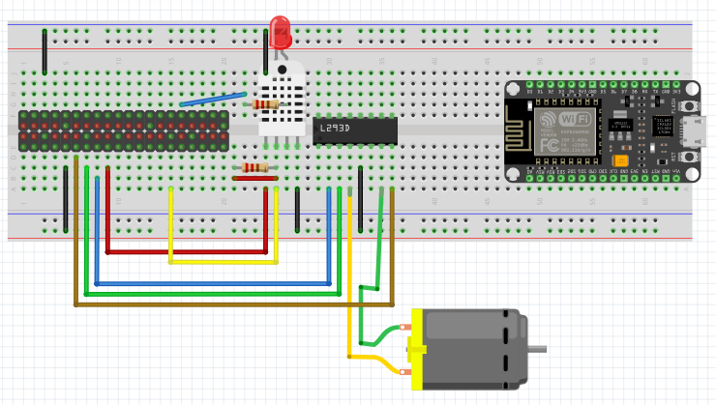
Phases and their tasks
Phase 2 - Wiring

Slide 16
Phases and their tasks
Phase 3 - description
In this part, we had to use a photoresistor with the ESP8266/ESP32 to measure light. We then sent this data to the Raspberry Pi and MQTT broker. If the light went below 400, we turned on an LED and sent an email. The dashboard had to show the current light level, its status, and confirm the email was sent.

Slide 17
Phases and their tasks
Phase 3 - UTILITIES
Components
Photoresistor
Resistors
Wires
Breadboard
Raspberry Pi
ESP8266 or ESP32
LED
Libraries
Sqlite3
paho.mqtt.client (mqtt)
datetime
time
Freenove_DHT
smtplib
MIMEText
MIMEMultipart
email
Imaplib
ESP8266WiFi.h
PubSubClient.h
Arduino.h

Slide 18
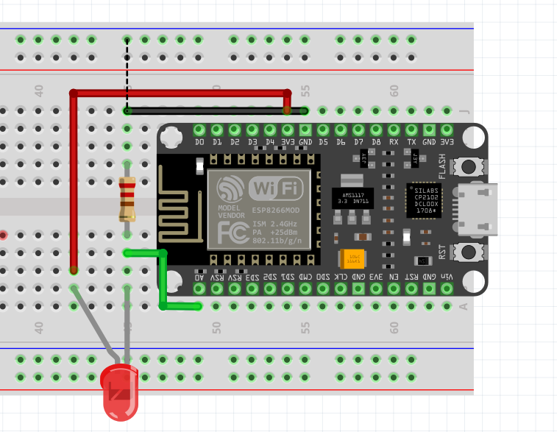
Phases and their tasks
Phase 3 - Wiring

Slide 19
Phases and their tasks
Phase 4 - description
Task #1 involves creating user profiles with RFID tag numbers, temperature thresholds, and light intensity thresholds. When an RFID tag is read, the system updates thresholds based on the user's profile and sends an email notifying the entry time. The dashboard displays user profile information.
Task #2 focuses on counting nearby Bluetooth-enabled devices using RSSI.

Slide 20
Phases and their tasks
Phase 4 - UTILITIES
Components
Photoresistor
Resistors
Wires
Breadboard
Raspberry Pi
ESP8266 or ESP32
LED
RC522 RFID Module
Libraries
Bluepy.btle
Sqlite3
datetime
time
Freenove_DHT
smtplib
MIMEText
MIMEMultipart
email
Imaplib
ESP8266WiFi.h
PubSubClient.h
Arduino.h

Slide 21
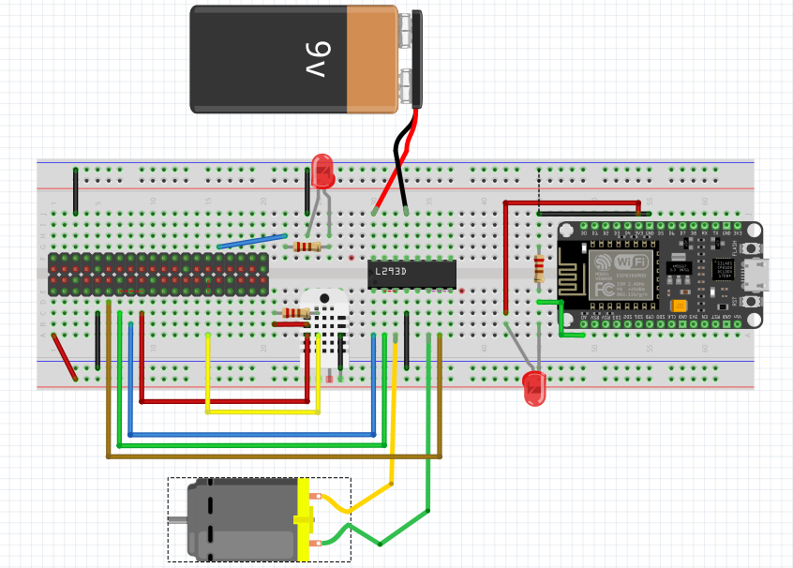
Phases and their tasks
Phase 4 - Wiring

Slide 22
Phases and their tasks
Phase 4 – In real time

Slide 23
Phases and their tasks
Phase 4 – Dashboard

Slide 24
Problems encountered
After getting kicked, I had little to no data on our project apart from phase 2 and phase 3 code.

Slide 25
Challenges and Accomplishments
PHASE 1
Installation of Dash was unclear when it came to the specifications and recommendations. Had to reinstall twice.
PHASE 2
Writing code for the email reading was very difficult with Gmail as the documentation online was either off or obsolete.
PHASE 3
Very difficult with no knowledge to set up the database
PHASE 4
Incredibly slow dashboard. Impossible to debug unless you use a second computer. Microcontrollers burning out from having to rewire every time you work on it.

Slide 26
Challenges and Accomplishments
We've successfully engineered a sophisticated simulated smart home, integrating an assortment of advanced components—sensors, motors, a single-board computer, and microcontrollers. Our project unfolded in four distinct phases, encompassing the development of a smart thermometer system, an intelligent lighting setup, an occupancy detection system, and a personalized user profile module.

Slide 27
THANK YOU
Mihai Serban​

Slide 28
We made it

